Slide 1

“The King Who Holds
All Things Together”
Colossians 1:11-20

Slide 2

Standing Between the Seasons

Slide 3

Colossian Problem…
Our Problem
Jesus is fine…
but do we need
something more?
We chase fullness in:
productivity, control,
spiritual effort
What if the world is out of control?
What if I’m not enough?
What if the darkness wins?

Slide 4
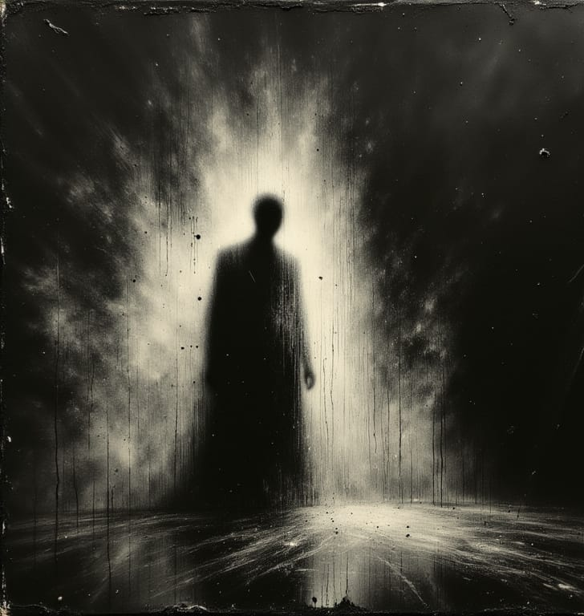
The Darkness is Real
Jeremiah: corrupt leaders:
“Woe to the shepherds who are destroying and scattering”
Zechariah: “those living in darkness and
the shadow of death”
But the darkness
is not the king of the world

Slide 5
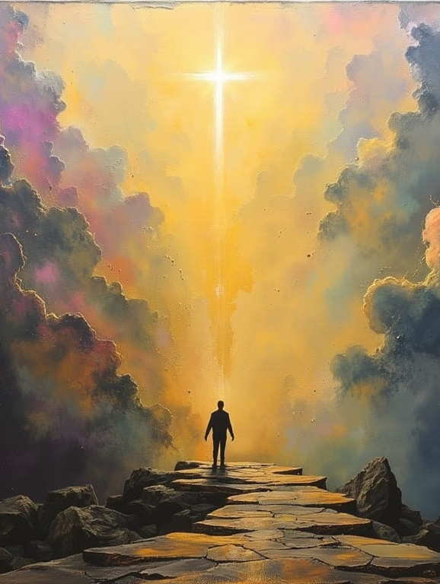
The Great Rescue
God rescued us from the power of darkness
Transferred us into the kingdom of His Son
Benedictus: “He has come to His people and set them free”

Slide 6
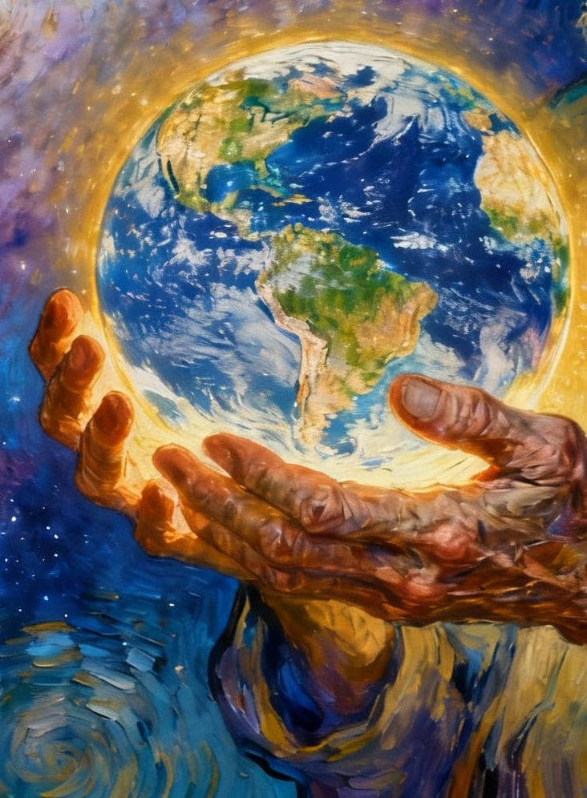
The Cosmic Christ
He is the image of the invisible God
In Him all things were created…
and hold together
Christ is King
of all things

Slide 7
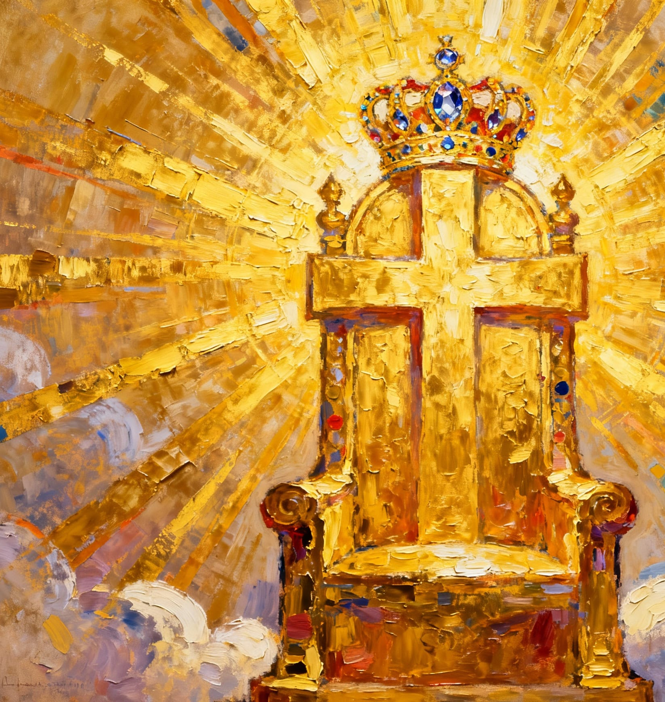
The Unexpected Throne
Through Him God reconciled all things
Making peace through the blood of His cross
The moment He looks weakest… is the moment He conquers

Slide 8

Living in His Kingdom
Live unafraid →
trust Christ holds you and the world
Stop chasing extra fullness →
rest in His gift
Join His work of peace →
bring reconciliation to your life

Slide 9
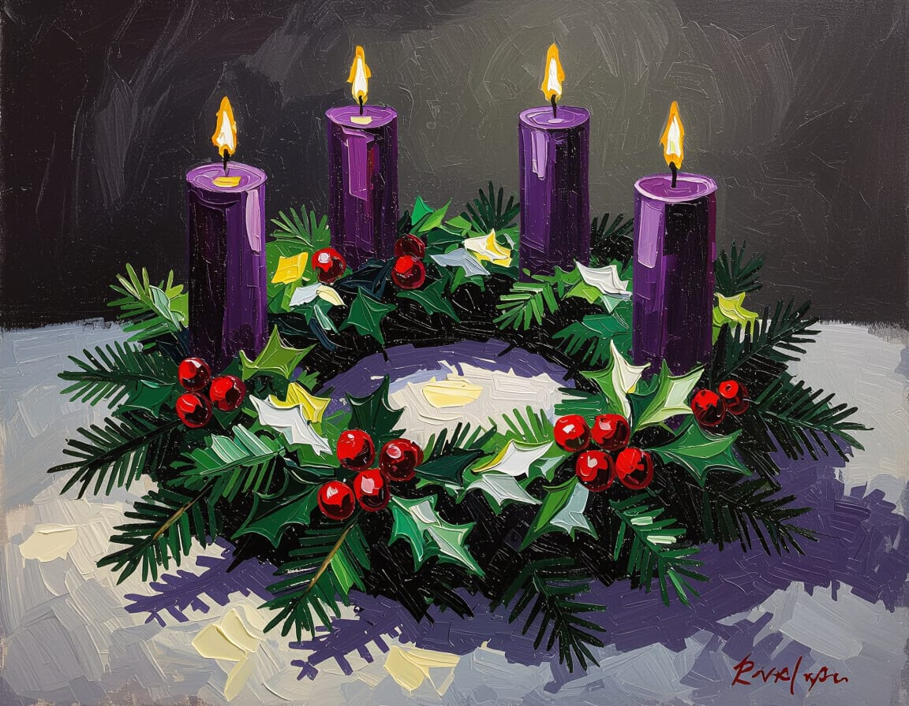
Looking Forward
Christ is King
He holds all things together
The One who started all things will finish all things

Slide 10

Live unafraid
Rest in
his gift
Carry his peace

